Slide 1
Halliday & Resnick’s
Fundamentals of Physics
Extended Edition Wiley
Chapter 22
Jearl Walker
Electric Fields

Slide 2
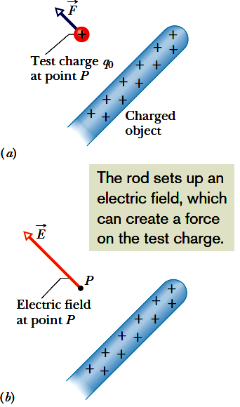

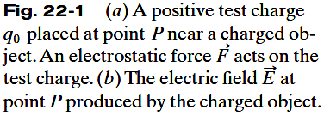
22.2 The Electric Field:
The Electric Field is a vector field.
The electric field, E, consists of a distribution of vectors, one for each point in the region around a charged object, such as a charged rod.
We can define the electric field at some point near the charged object, such as point P in Fig. 22-1a, as follows:
A positive test charge q₀, placed at the point will experience an electrostatic force, F.
The electric field at point P due to the charged object is defined as the electric field, E, at that point:
The SI unit for the electric field is the newton per coulomb (N/C).

Slide 3
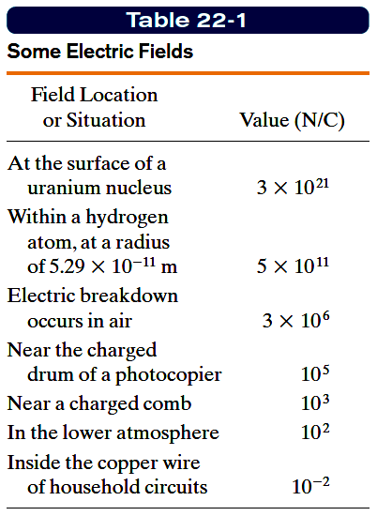
22.2 The Electric Field:

Slide 4
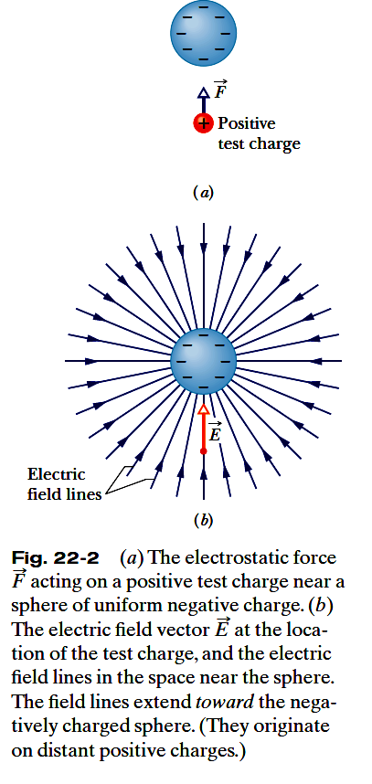
22.3 Electric Field Lines:
At any point, the direction of a straight field line or the direction of the tangent to a curved field line gives the direction of at that point.
The field lines are drawn so that the number of lines per unit area, measured in a plane that is perpendicular to the lines, is proportional to the magnitude of E.
  Thus, E is large where field lines are close together
  and small where they are far apart.

Slide 5
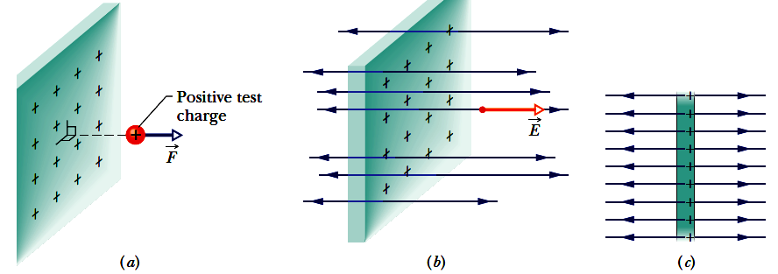
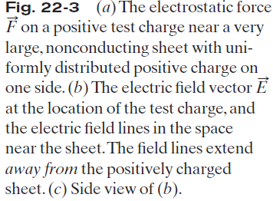
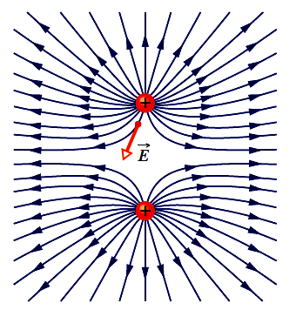
22.3 Electric Field Lines:
Fig. 22-4 Field lines for two equal positive
point charges. The charges repel each other.
(The lines terminate on distant negative
charges.) The electric field vector at one point is shown; note that it is tangent to the field line through that point.

Slide 6
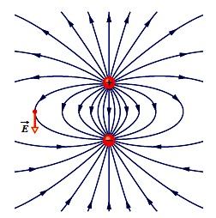
Fig. 22-5 Field lines for a positive point
charge and a nearby negative point charge
that are equal in magnitude. The charges attract
each other. The pattern of field lines and
the electric field it represents have rotational
symmetry about an axis passing through both
charges in the plane of the page. The electric
field vector at one point is shown; the vector
is tangent to the field line through the point.

Slide 7
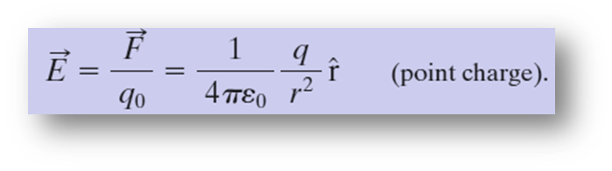

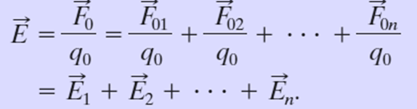
22.4 The Electric Field due to a Point:
To find the electric field due to a point charge q (or charged particle) at any point a distance r from the point charge, we put a positive test charge q₀ at that point.
The direction of E is directly away from the point charge if q is positive, and directly toward the point charge if q is negative. The electric field vector is:
The net, or resultant, electric field due to more than one point charge can be found by the superposition principle. If we place a positive test charge q₀ near n point charges q₁, q₂, . . . , q_{n}, then, the net force, F_{o}, from the n point charges acting on the test charge is
The net electric field at the position of the test charge is

Slide 8


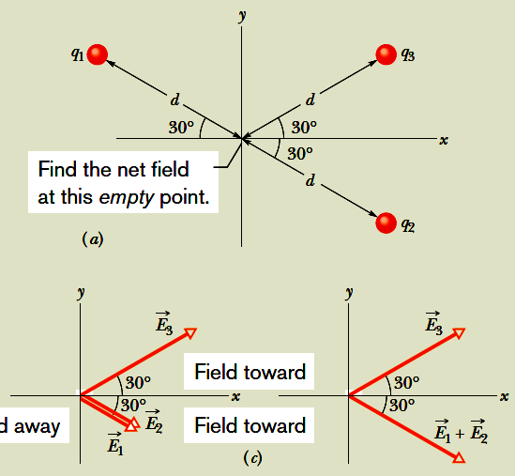
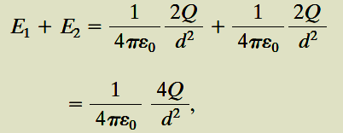
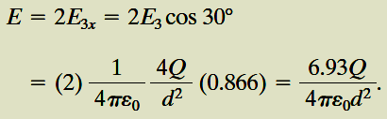
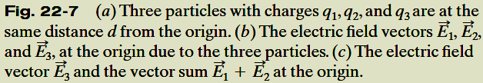
Example, The net electric field due to three charges:
From the symmetry of Fig. 22-7c, we realize that the equal y components of our two vectors cancel and the equal x components add.
Thus, the net electric field at the origin
is in the positive direction of the x axis and has the magnitude

Slide 9
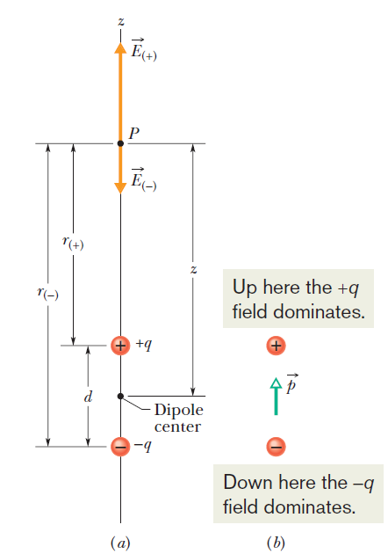
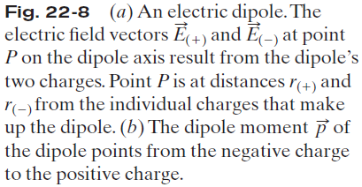
22.5 The Electric Field due to an Electric Dipole:

Slide 10
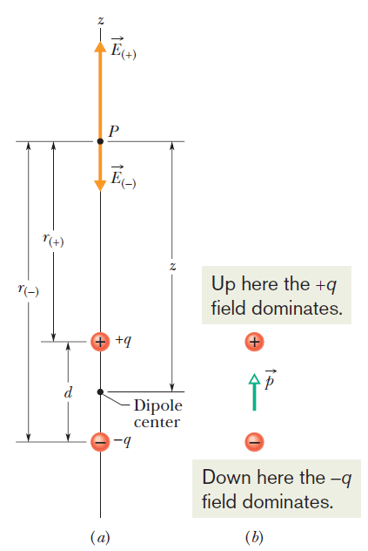
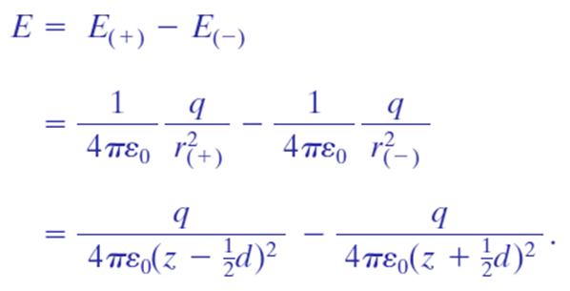
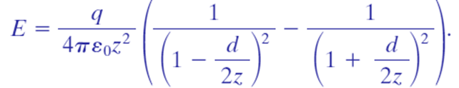
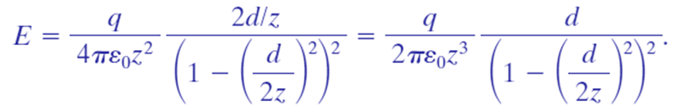


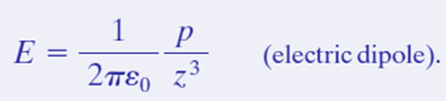
22.5 The Electric Field due to an Electric Dipole:
From symmetry, the electric field E at point P—and also the fields E₊ and E₋ due to the separate charges that make up the dipole—must lie along the dipole axis, which we have taken to be a z axis. From the superposition principle for electric fields, the magnitude E of the electric field at P is
The product qd, which involves the two intrinsic properties q and d of the dipole, is the magnitude p of a vector quantity known as the electric dipole moment of the dipole.

Slide 11
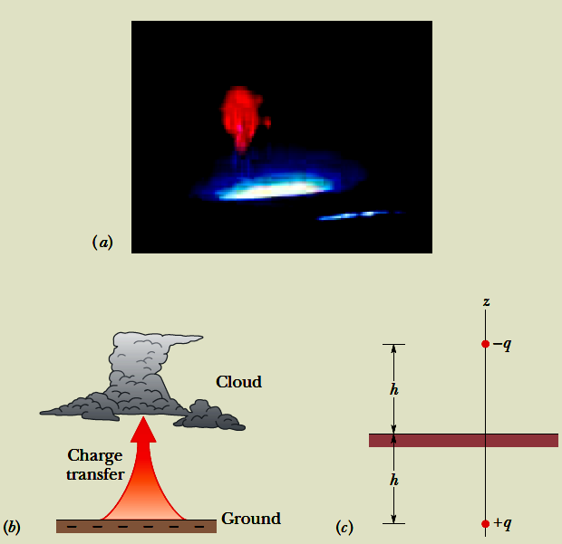

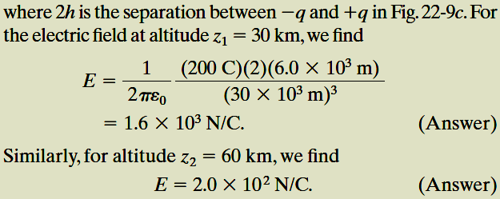
Example, Electric Dipole and Atmospheric
Sprites:
We can model the electric field due to the charges in the clouds and the ground
by assuming a vertical electric dipole that has charge -q at cloud height h and charge +q at below-ground depth h (Fig. 22-9c). If q =200 C and h =6.0 km, what is the magnitude of
the dipole’s electric field at altitude z₁ =30 km somewhat above the clouds and altitude z₂ =60 km somewhat above the stratosphere?
Sprites (Fig. 22-9a) are huge flashes that occur far above a large thunderstorm. They are still not well understood but are believed to be produced when especially powerful lightning occurs between the ground and storm clouds, particularly when the lightning transfers a huge amount of negative charge -q from the ground to the base of the clouds (Fig. 22-9b).

Slide 12
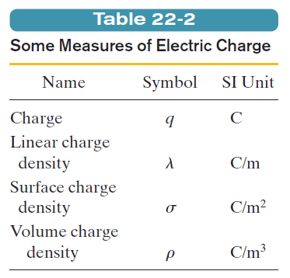
22.6 The Electric Field due to a Continuous Charge:
When we deal with continuous charge distributions, it is most convenient to
express the charge on an object as a charge density rather than as a total charge.
For a line of charge, for example, we would report the linear charge density
(or charge per unit length) λ, whose SI unit is the coulomb per meter.
Table 22-2 shows the other charge densities we shall be using.

Slide 13

22.8: A Point Charge in an Electric Field
When a charged particle, of charge q, is in an electric field, E, set up by other stationary or slowly moving charges, an electrostatic force, F, acts on the charged particle as given by the above equation.

Slide 14
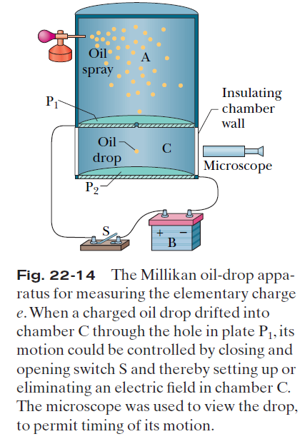
22.8: A Point Charge in an Electric Field:
Measuring the Elementary Charge

Slide 15
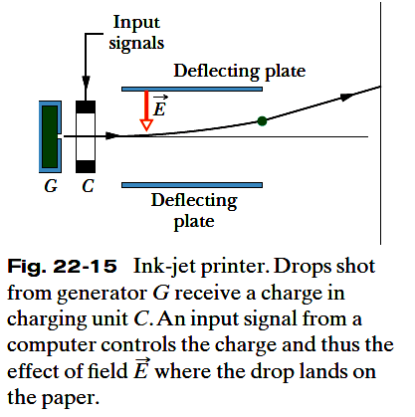
Ink-Jet Printing
The need for high-quality, high-speed printing has caused a search for an alternative to impact printing, such as occurs in a standard typewriter.
Building up letters by squirting tiny drops of ink at the paper is one such alternative.
Figure shows a negatively charged drop moving between two conducting deflecting plates, between which a uniform, downward-directed electric field has been set up.
The drop is deflected upward according to Eq. F=qE and then strikes the paper at a position that is determined by the magnitudes of and the charge q of the drop.
In practice, E is held constant and the position of the drop is determined by the charge q delivered to the drop in the charging unit, through which the drop must pass before entering the deflecting system.
The charging unit, in turn, is activated by electronic signals that encode the material to be printed.

Slide 16
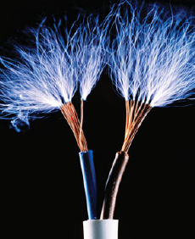
Electrical Breakdown and Sparking
If the magnitude of an electric field in air exceeds a certain critical value Ec, the air undergoes electrical breakdown, a process whereby the field removes electrons from the atoms in the air.
The air then begins to conduct electric current because the freed electrons are propelled into motion by the field.
As they move, they collide with any atoms in their path, causing those atoms to emit light.
We can see the paths, commonly called sparks, taken by the freed electrons because of that emitted light.
Figure 22-18 shows sparks above charged metal wires where the electric fields due to the wires cause electrical breakdown of the air.
Figure 22-18 The metal wires are so charged that the electric fields they produce in the
surrounding space cause the air there to undergo electrical breakdown.

Slide 17
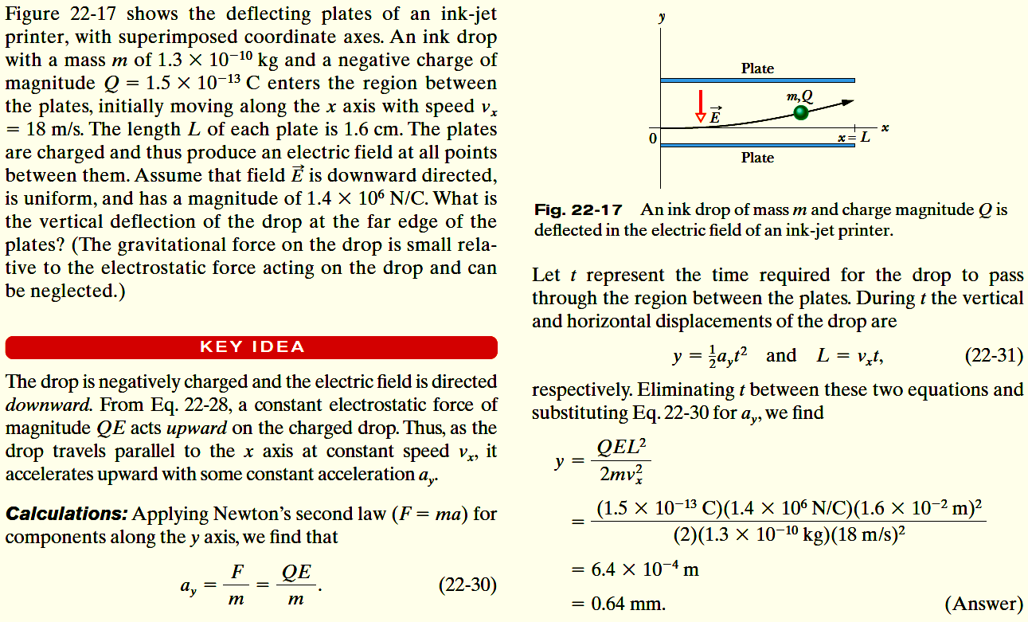
Example, Motion of a Charged Particle in an Electric Field

